Slide 1
Developing an AI System for Answer Extraction from Quranic Verses

Slide 2
Team Members
Abdelrahman Namir Ahmed Abdelkader Abdelrahman Ahmed Haleem Hussien
Aboubakr Ashraf Ali Elsayed
Omar Alaa AlSayed Hegazy Sara Ashraf Ragab Mahrous Sara Yasser Mohamed Elabasy
Supervisors:
Prof. Shaimaa Lazem Dr. Ahmed El-Sayed Dr. Maged Abdelaty

Slide 3
General Topic & Background
General Topic:
This project focuses on developing a specialized question-answering (QA) system designed to extract answers directly from the Quranic text. The system leverages Deep
Learning techniques to enable users to ask questions about specific Quranic passages and receive contextually accurate answers derived from the text itself.
Background:
The Quran is a foundational text of Islamic theology, providing guidance on various aspects of life. Due to its complex linguistic structure, interacting with the Quranic text can
be challenging. Traditional methods of understanding the Quran often involve scholarly
interpretation, which can be time-consuming and require substantial expertise.
Recent advancements in NLP offer an opportunity to create tools that facilitate more direct
engagement with the Quranic text. By developing a QA system specifically trained on the Quran, users can receive precise answers to their questions.

Slide 4
General Topic & Background
Advantages:
Direct Answer Extraction: This approach enables users to receive answers
directly from the Quranic text without additional layers of interpretation or translation.
Enhanced Accuracy: By focusing on Quranic text alone, the system can provide precise answers that are contextually aligned with the original scripture.
Disadvantages:
Lack of Context: the model take an irrelevant question to the given passage, the
answer will be wrong.

Slide 5
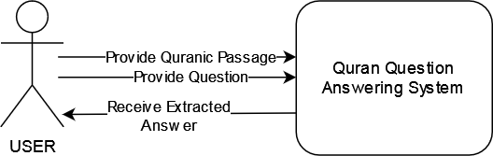
System Usage
The program runs a Python cell where the user is prompted to input a Quranic passage and a related question. Upon receiving these inputs, the system processes the passage to extract and display the answer to the user's question. This interactive process ensures that users receive accurate answers based on the specific text they provide.

Slide 6
Approach & Methodology
Data Preparation & Analysis: Base:
The dataset for this Arabic Reading Comprehension task, focused on the Holy
Qur’an, is designed to evaluate language understanding in computer systems by posing questions over given text passages. The Holy Qur’an, written in Classical Arabic, contains 114 chapters and 6,236 verses, totaling over 80,000 words.
Dataset description:
The dataset, called QRCD (Qur'anic Reading Comprehension Dataset), comprises 1,093 question-passage pairs and 1,337 question-passage-answer triplets, where each passage contains consecutive verses from the Qur’an and questions are posed in Modern Standard Arabic (MSA).
Steps for preparing the dataset:
Converts JSON files to a Python dictionaries.
Extract passages, questions, and answers and store them in lists (One question and passage pair can have multiple answers, so we have to split them).
Split multiple answers per passage-question pair. So each row can have one
passage, one question, and one answer.

Slide 7
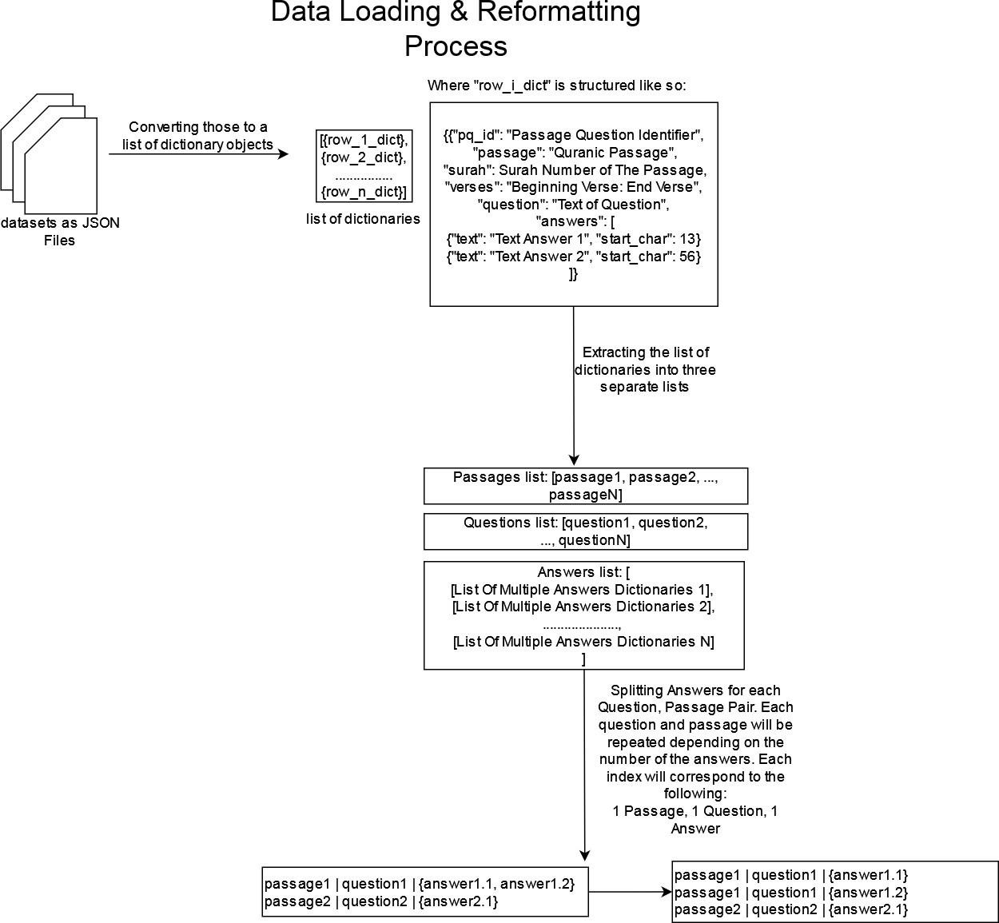

Slide 8
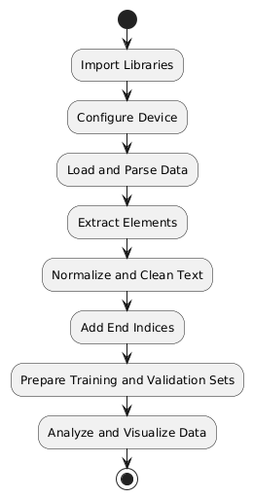
Preprocessing Steps
Removing Diacritics
Purpose: Simplify Arabic text by removing diacritics (Tashkeel) to avoid confusion.
Diacritics Removed:
\u064B (¤ ): Fathatan \u064C (¤ ): Dammatan \u064D (¤ ): Kasratan
\u064E (¤ | ): Fatha | \u064F (¤ | ): Damma | \u0650 (¤ | ): Kasra
\u0651 (¤ | ): Shadda | \u0652 (¤ | ): Sukun
Removing Digits and Punctuation:
We remove all numbers [0-9] from all three lists in each
individual string, and we remove the following punctuations:
! " # $ % & ' ( ) * + , / : ; < = > @ [ \ ] ^ _ ` { | } ~ » « “ ” The reason behind this is that we need to reduce the number of useless characters in our text that could potentially degrade the models' performances.

Slide 9
Preprocessing Steps
Adding End Indices to Answers
We need to calculate the ending position of each answer within its context passage. This information is crucial for training tasks like question answering, where the model needs to predict both the start and end positions of the answer. We also need to ensure these character positions are correct.
Modifying Text in Answers
The answers are structured in a way that each item in the answers list is a dictionary of three keys. ‘text’ Which is the text of the answer, ‘start_char’ which is the index of the beginning character with respect to the context, ‘end_char’ is the end of the answer character. This function applies text modification functions (like
normalization and punctuation removal) to the answer texts without altering the overall structure of the answer dictionaries.

Slide 10
Dataset Analysis
Text Length Statistics & Visualizing Text Length:
We use various ways to analyze our data in terms of the amount of characters in each of the three lists. These include finding the minimum, maximum, mean, and median of the lengths. The visualization are basically some histogram graphs of those lengths.

Slide 11
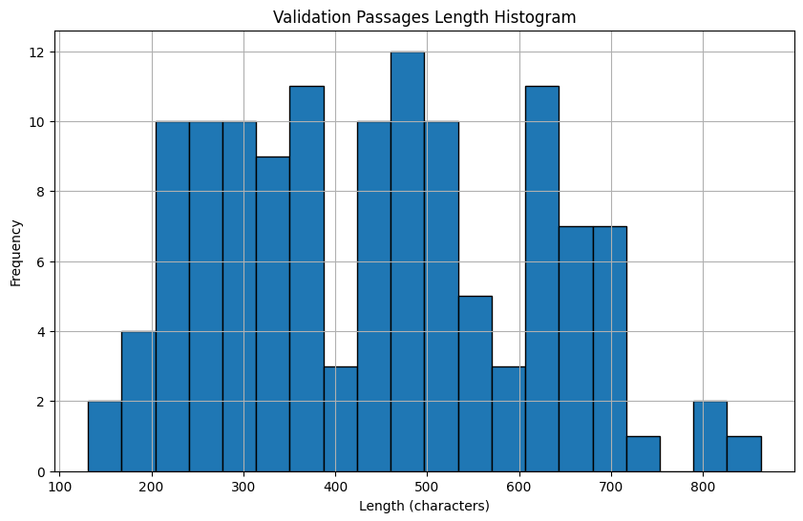

Slide 12
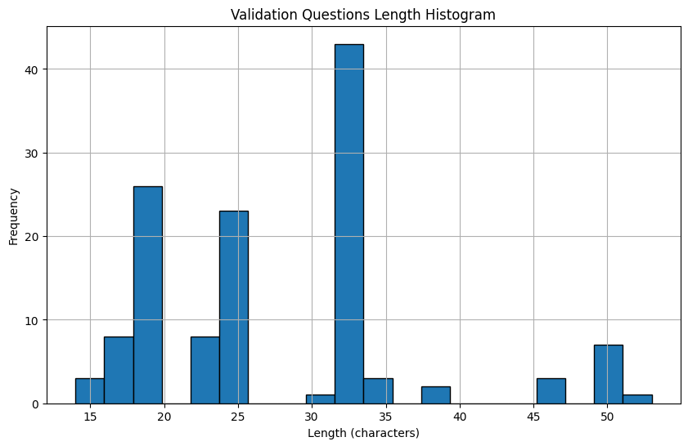

Slide 13
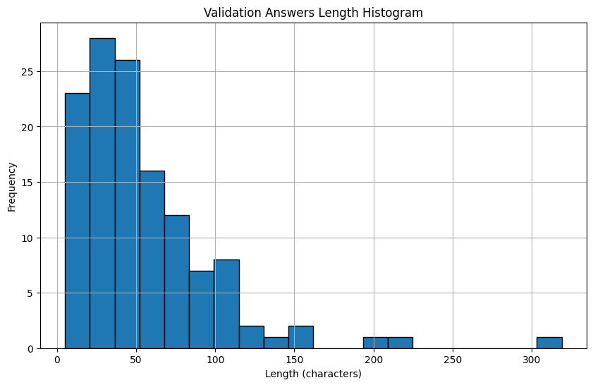

Slide 14
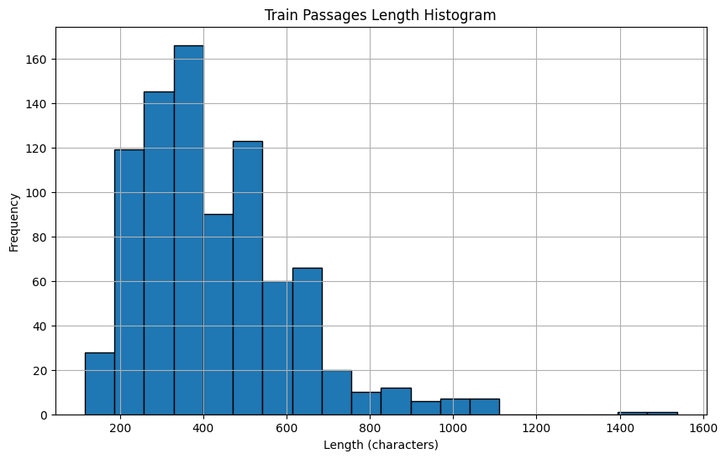

Slide 15
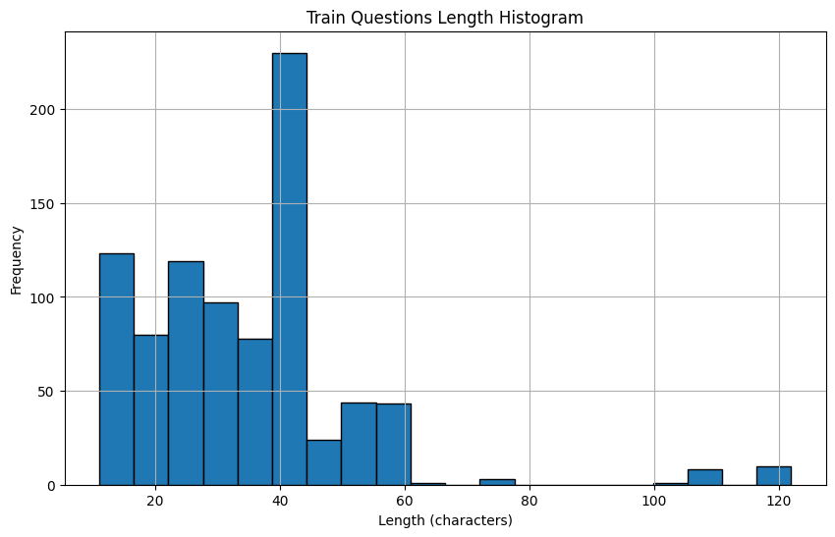

Slide 16
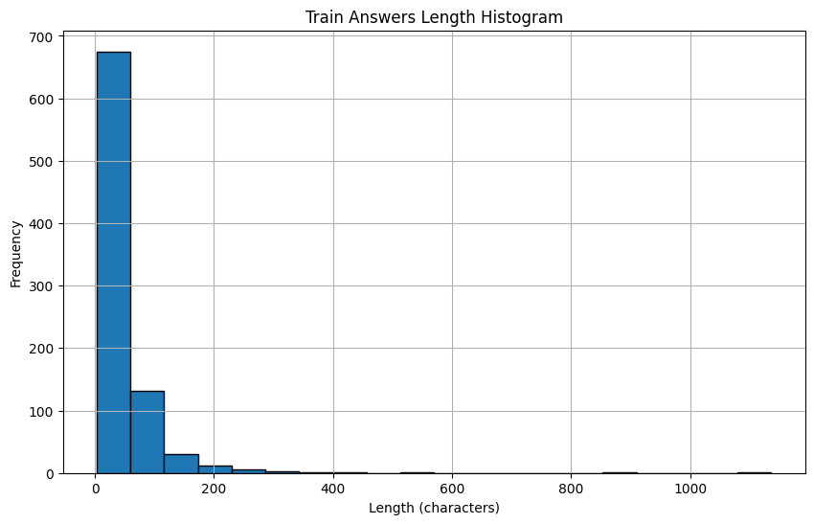

Slide 17
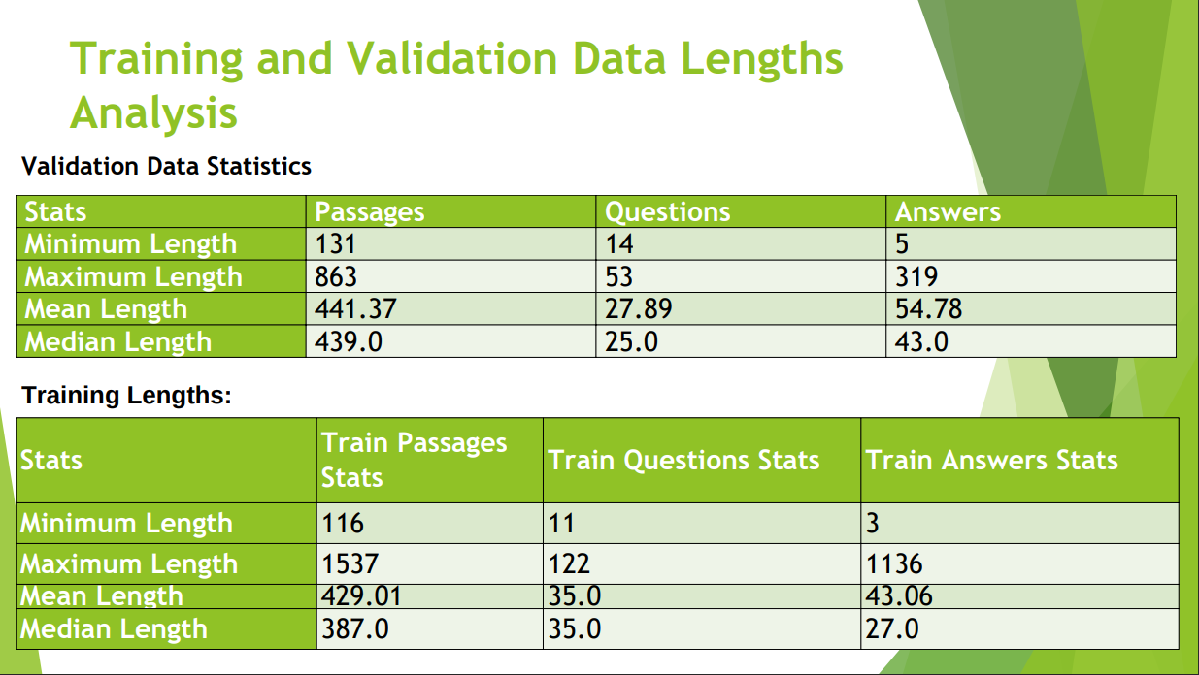
Training and Validation Data Lengths Analysis
Validation Data Statistics
r
131
863 14 5
441.37 53 319
439.0 27.89 54.78
25.0
43.0
Training Lengths:
Answers Stats
116 11 3
M 1537 122 1136
M 429.01 35.0 43.06
M 387.0 35.0 27.0

Slide 18
Text Tokenization/Encoding
Understanding Tokenization
Tokenization is the process of converting a string of text into smaller units called tokens. These tokens can be words, subwords, or even individual characters, depending on the tokenization strategy. Tokenization is needed in order to have a more unified look for the inputs.
We essentially tokenize both the passages and questions and then append the tokens of both of them with the [SEP] token in between.
The tokenizer function will return a dictionary of the final tokenization, the
input ids form, and their attention mask. Ex:
token_type_ids: [[CLS], I, love, reading, [SEP], what, do, you, love, [PAD],….,
[PAD]]
input_ids: [2, 24, 15, 16, 80, 20, 34, 12, 15, 31, …, 31]
attention_mask: [1, 1, 1, 1, 0, 0, 0, 0, 0, 0,….,0]

Slide 19
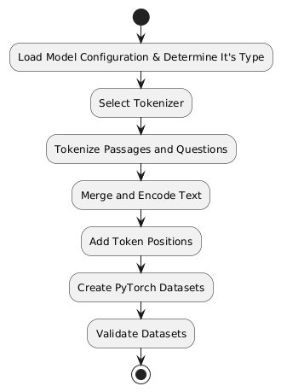
Text Tokenization/Encoding
Handling Edge Cases
The function handles cases where start or end positions are not found by assigning default values, such as the maximum length of the model's token sequence. We need to convert the start and ending character indices for the answers to token indices. This shall insert those two tokens positions as key and values to the
encodings dicitionary.
Creating PyTorch Datasets
We create a custom PyTorch dataset class initializes with
encodings and implements methods to return data in tensor form. The tokenized encodings are transformed into PyTorch tensors, making them compatible with PyTorch models for training and
evaluation.
Finally, we then integrate all of the encoding process in a single function.

Slide 20
Model Training/Evaluation Pipeline
We'll explore the process of initializing and training a question-answering model, with a focus on the use of pre-trained models, data loaders, optimizers, and evaluation metrics. Model Initialization:
The process begins with selecting a pre-trained model tailored for question-answering
tasks. For this pipeline, several model types are considered: BERT, T5, GPT-2, and a more generic models. Each of these models comes with its own pre-trained weights and architecture, allowing them to be fine-tuned for specific tasks.
Data Preparation and Training Loop:
Once the model is initialized, the next step involves preparing the training data and setting up
the training environment. This includes:
Data Loading: Using PyTorch's DataLoader, the training data is batched and shuffled to facilitate efficient training.
Optimizer: The AdamW optimizer with weight decay is chosen for its robustness and effectiveness in reducing overfitting.
Progress Tracking: To monitor the training progress, the tqdm library is used to provide a
visual progress bar.

Slide 21
Model Training/Evaluation Pipeline
Evaluation and Metrics: Evaluating the trained model involves assessing its performance on a validation dataset. The evaluate function computes various metrics, including:
Loss: The average loss over all validation batches, which provides a measure of how well the model's predictions align with the actual answers.
Accuracy, Precision, Recall, and F1 Score: These metrics are computed for
both the start and end positions of the answer spans, offering insights into how well the model identifies the beginning and end of the answer in the text.
Mean Reciprocal Rank (MRR): Measures the average rank of the first correct
answer, providing a gauge of how quickly the model retrieves the correct answer.

Slide 22
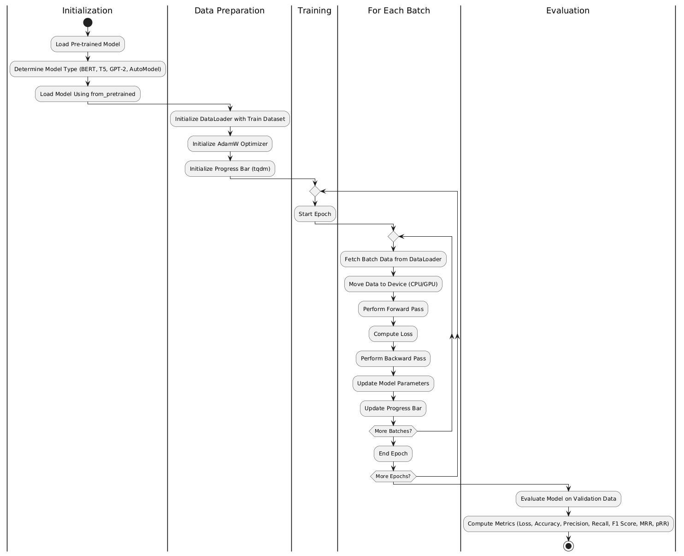

Slide 23
Training & Evaluation with BERT Models
General Overview
BERT: it’s a Bidirectional Encoder based transformer model. The base version is comprised of 12 layers of encoders. every output element is connected to every input element, and the weightings between them are dynamically calculated based upon their connection.
AraBERT: is a pre-trained language model specifically designed for the Arabic
language, based on Google's BERT architecture. AraBERT uses the same configuration as BERT-Base, which includes 12 layers, 768 hidden units, and 12 attention heads. It Primarily focused on Modern Standard Arabic (MSA).
MARBERT: is another advanced Arabic language model, focusing on both Dialectal
Arabic (DA) and Modern Standard Arabic (MSA). MARBERT is trained on a large- scale dataset of Arabic tweets (1 billion tweets). MARBERT aims to understand both Dialectal Arabic and Modern Standard Arabic, making it versatile for various Arabic language tasks.

Slide 24
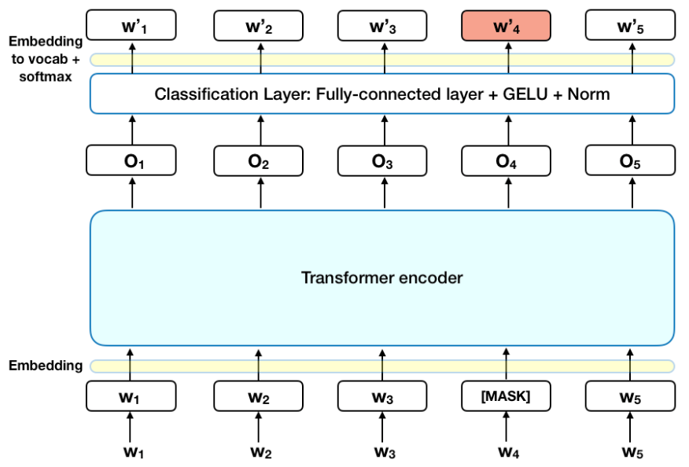

Slide 25
Model Training Approaches
Training AraBERT V2 Without Preprocessing
Process: Convert data, train with default parameters (batch size: 2, learning rate: 2e-5, epochs: 5).
We then save the trained model for future use and to reimport for the evaluation and performance measures calculation.
Training AraBERT V2 With Preprocessing
Process: Apply preprocessing to data before training.
Evaluating Both Models
Process: Load models and evaluate on validation sets.
Metrics: Compare validation loss, accuracy, precision, recall, F1 score, MRR.

Slide 26
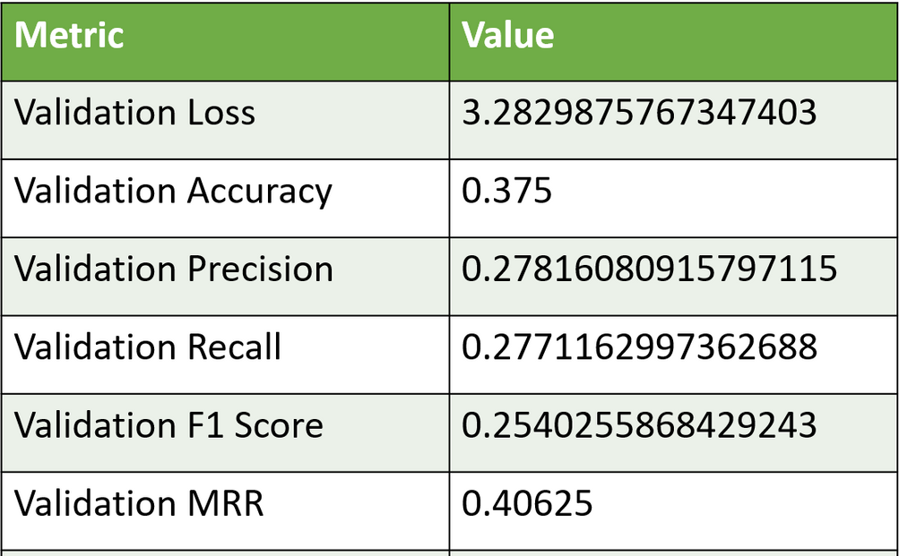
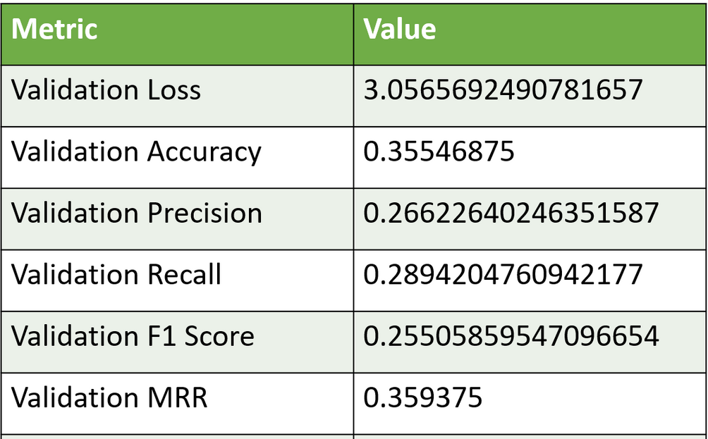
Performance Metrics Comparison
Arabert V2 Trained on Vanilla QRCD Dataset Arabert V2 Trained on Preprocessed QRCD Dataset

Slide 27
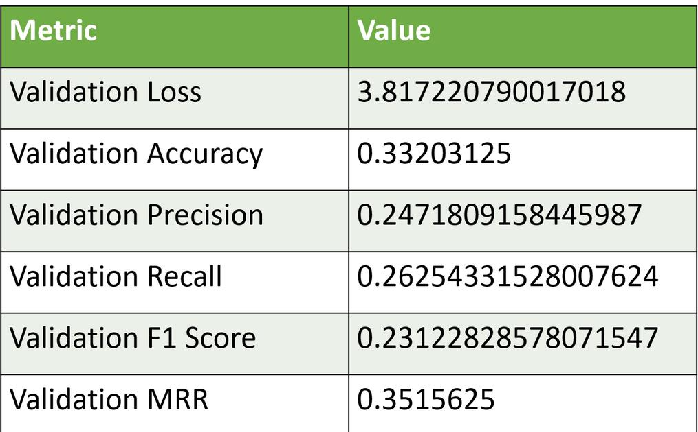
Training & Evaluation with MARBERT
MARBERT Training
Process: Similar to AraBERT, convert data, train, and save model and tokenizer.
Evaluation: Print performance metrics on the validation set.

Slide 28
Hyperparameter Optimization with Grid Search
Grid Search is the procedure in which we try to find the best hyper parameters, for a given model.
For integrating the model training process with scikit-learn's API, a custom
transformer class is implemented which inherit from BaseEstimator and ClassifierMixin allowing it to fit into the scikit-learn ecosystem.
Using the GridSearchCV method we can hookup our training loop to it and define
our search space like so:
param_grid = {'batch_size': [2, 4, 6], 'learning_rate': [2e-5, 1e-4, 2e-4], 'epochs': [2, 5, 10]}
Unfortunately, due to the limited budget and processing power we have, we
weren’t able to get the best hyperparameters or graph them. This thing took forever and the best computer we had crashed after 11 hours during this procedure.

Slide 29
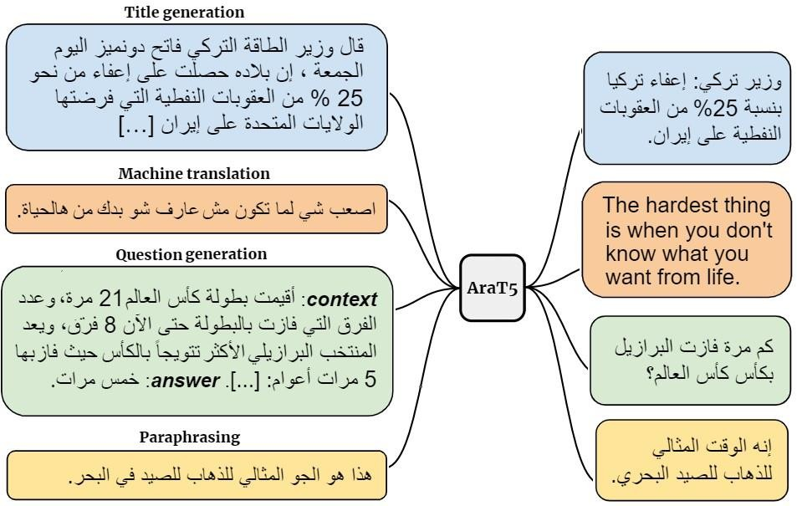
Testing with Another Model: T5
AraT5 is a multi tasking model optimized for the Arabic language. It can do Question Answering, Summarization, and translation tasks simultaneously for instance. It is an encoder-decoder model on a multi-task mixture of unsupervised and supervised tasks and for which each task is converted into a text-to-text format.
This one required a lot of memory which we didn’t have on our computer. And all we could do was to train the model on the validation set to ensure that our pipeline is compatible with the majority of models we throw at it. And training it on Colab will take forever.

Slide 30
Part 2: GUI Application Development

Slide 31
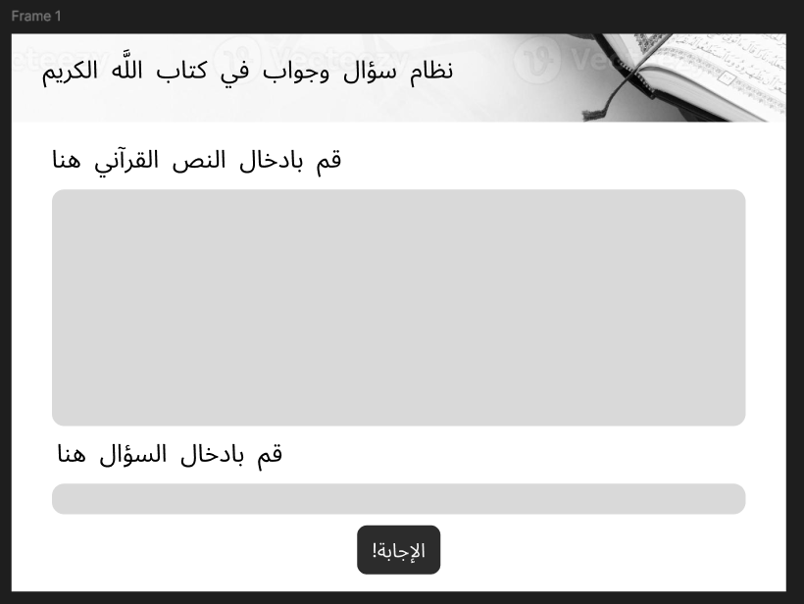
Tkinter GUI Design
We used an online platform figma.com to model the shape of the main window of the program and add the banner picture above as well as defining the button shape, font style, text area and text box.
Then we convert the design we made online into a Tkinter python code and extract the frontend images (assets) into a separate folder to be loaded using Tkinter Designer.

Slide 32
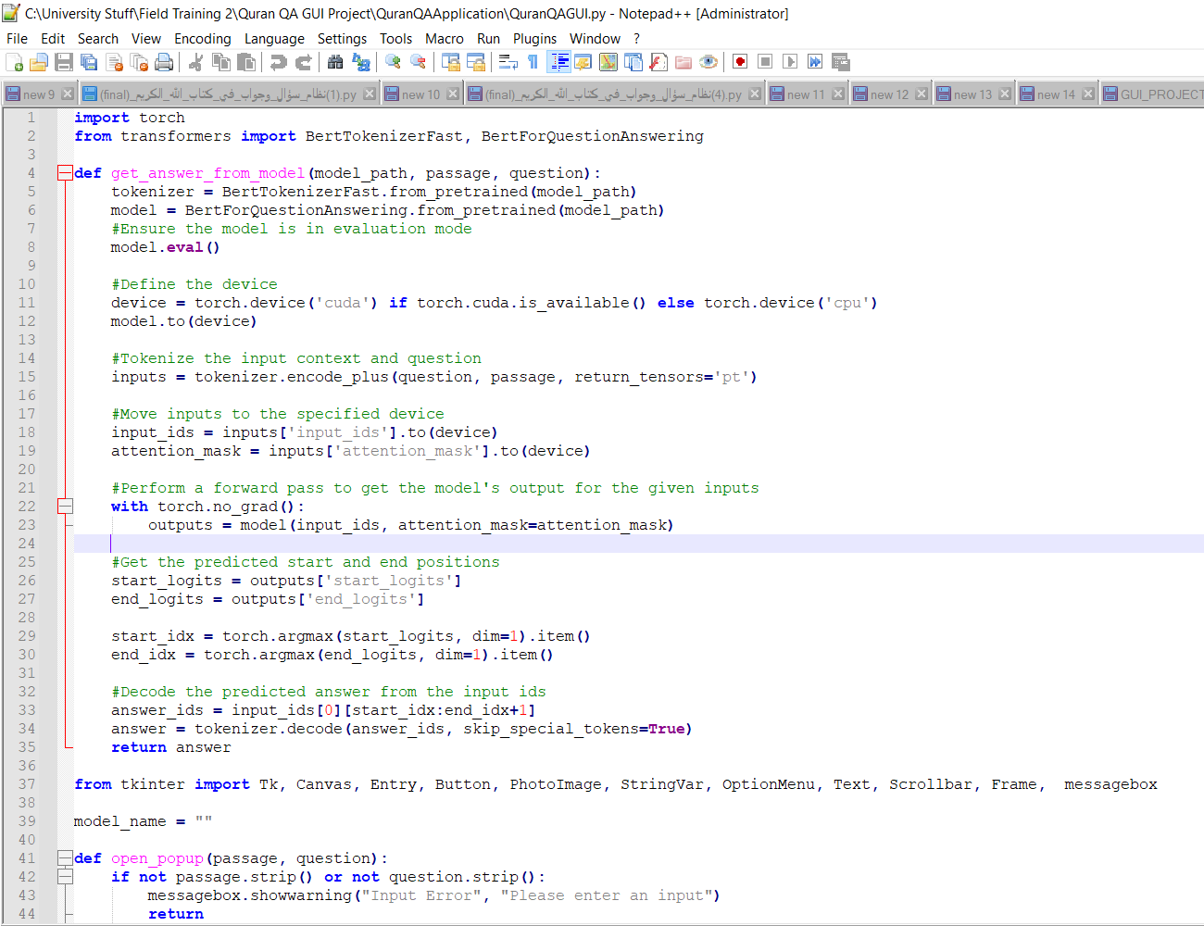
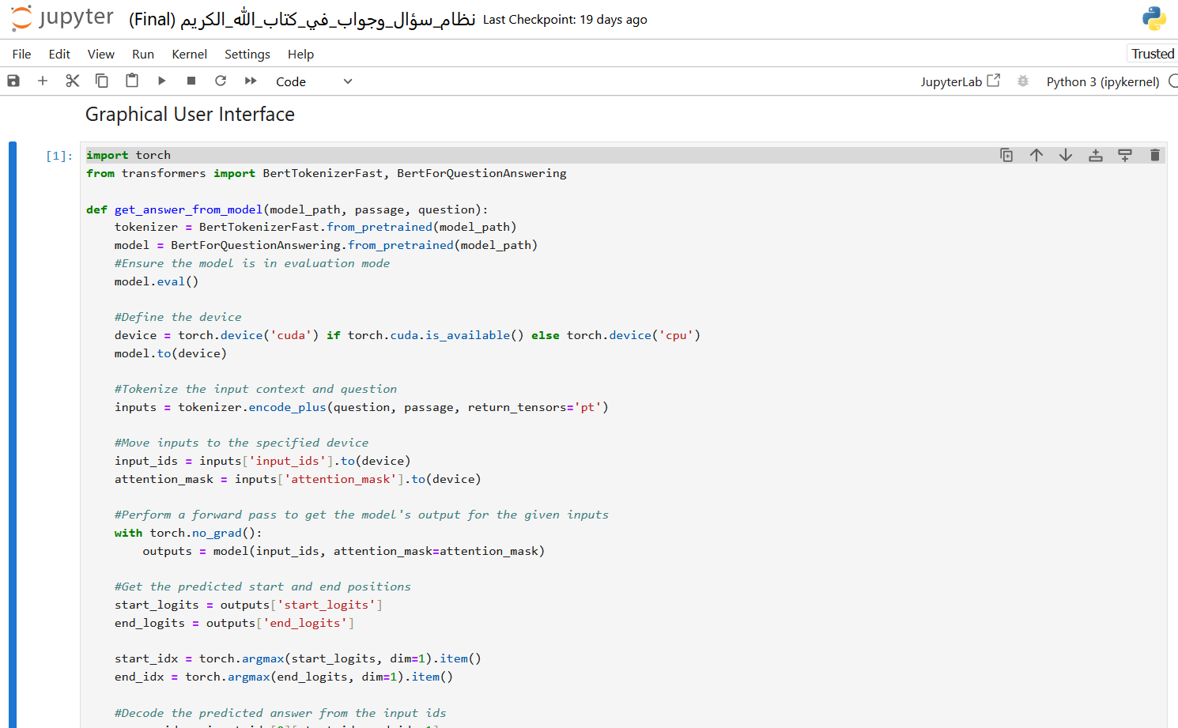
Integrating the QA Code to the GUI
We copied and pasted the code to the main development notebook for editing and refinement as well as integrating both the GUI components and the Question Answering code together. After fully testing the program, we copy the relevant cells to a .PY file to be run standalone and be used for compiling later on.

Slide 33
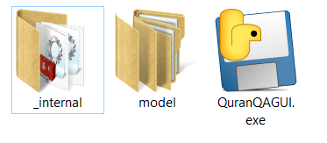
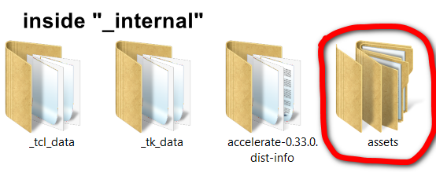
Converting the code to a desktop application
We have included two important folders for the program to function properly, one is called the “model” folder, which contains the AraBERT & MarBERT models pretrained for the Quranic extractive question/answering task.
The other folder is the “assets” folder which includes some gui graphic elements, we put that to the “_internal” folder for the program to work. There’s no need to install any other software as long as you have visual redistributable c++ 2022 installed on your PC because it contains necessary dependencies for the program to work, otherwise we haven’t encountered any issues on other machines. You can launch the program from QuranQAGUI.exe.
The Internal folder contains all the libraries, dependencies, and python runtime files.

Slide 34
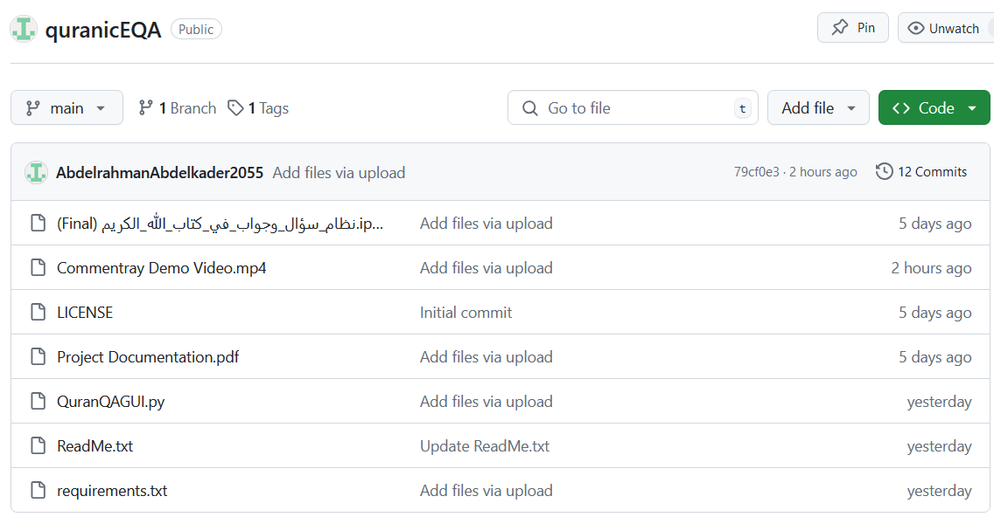
GitHub Repository Creation
We created a GitHub repository to publicly share the source code for the project and let the collaborators easily modify different elements of the project.
https://github.com/AbdelrahmanAbdelkader2055/quranicEQA

Slide 35
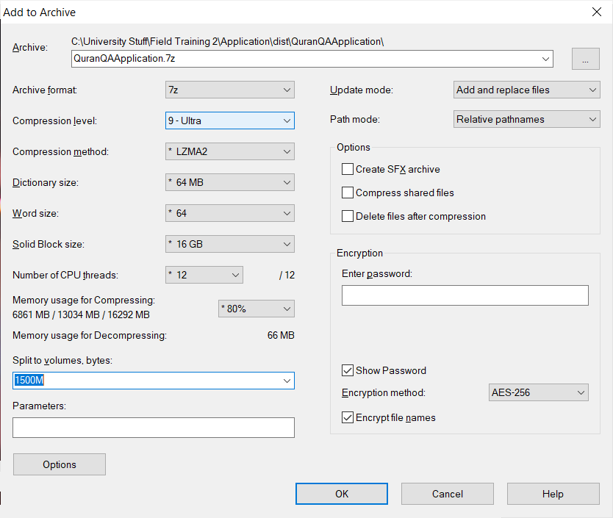
Program size reduction & compression
We have created a separate anaconda development environment for all the necessary libraries to be included to discard the irrelevant ones which we originally had for our development environment. That would end up saving over 1.5 GB of total program space. We then recompiled the code using Pyinstaller library command mentioned “Converting the code to a desktop application”. Finally, we heavily compressed the program folder using an archiver software known as 7zip and we used those settings and split them to two parts. Reducing the overall file size from 5.35GB to 2.36GB compressed.

Slide 36
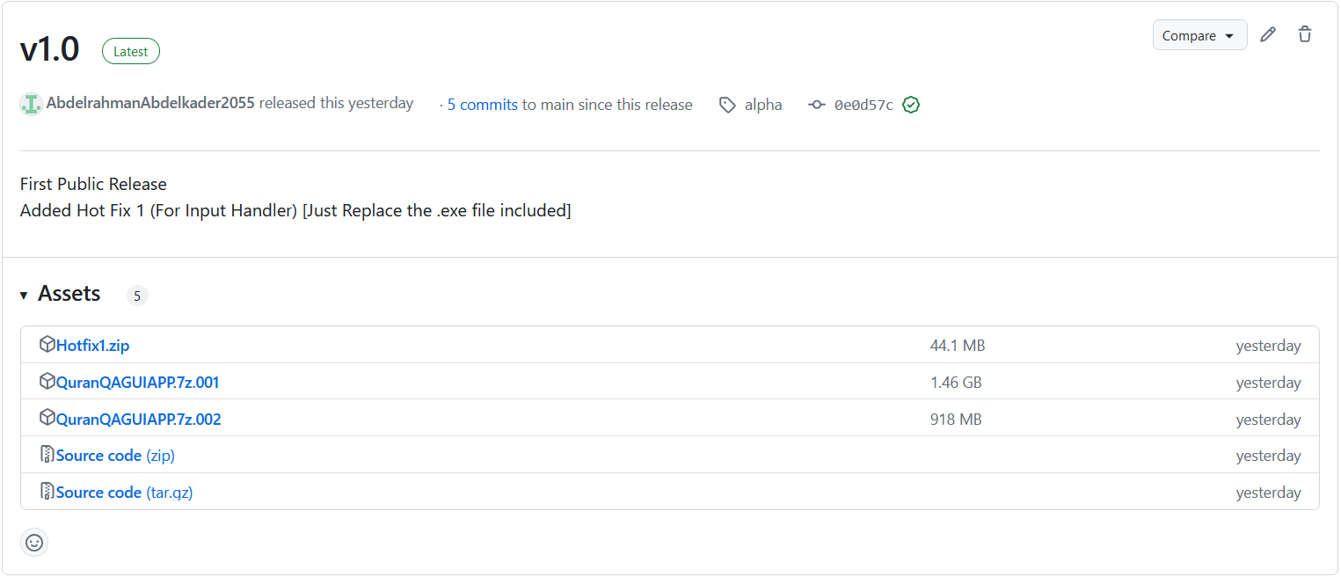
First Release Publication
We uploaded the two parts of the 7zip file to the GitHub repository’s releases section so the end user can download, extract and use this program without much hassle. It took us time to upload those two file due to the relatively large file sizes.

Slide 37
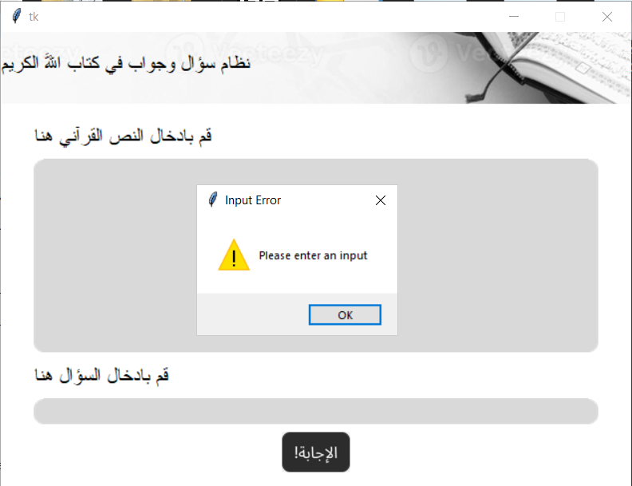
Input Handler Implementation
This feature was added late during development, and it checks for the inputs and see whether they’re empty or not. Added as hotfix 1 in GitHub.

Slide 38
Suggested Future Work
Advanced Preprocessing Techniques
Explore different text normalization and tokenization strategies. Better handling of Quranic diacritics.
Model Refinement and Complexity Handling
Develop or refine models to handle Quranic Arabic complexities. Integrate additional NLP functionalities.
Expansion and Enhancement of Datasets
Expand the Quranic dataset.
Incorporate additional Arabic text resources and transfer learning techniques.
Evaluation and Benchmarking
Continual evaluation and benchmarking against existing QA systems. Regularly update evaluation metrics specific to Quranic text.

Slide 39
Conclusion
Project Team Learning Outcomes
Skills Developed:
Advanced NLP models: AraBERT, MARBERT, T5.
Machine learning techniques: Model fine-tuning, dataset preparation, performance evaluation.
Preparedness for future AI and NLP endeavors.
Technological Impact:
Improved efficiency and accuracy in information retrieval from religious texts.
Enhanced usability and accessibility of religious texts.
Contribution to AI by addressing challenges of classical texts.

Slide 40
References:
1.(2024, June) wikipedia [online] authors unicode for arabic Arabic script in Unicode - Wikipedia
2.(2019) [online] Taha Zerrouki
ولا ﺪﻟ ا-ﻒﺋﺎﻇﻮﻟ ا— PyArabic: Python Library for Arabic 0.6.12 documentation
3. (2021) [online] James Briggs fine-tune-SQUAD.ipynb · GitHub 4.(2021) [online] James Briggs fine-tune-SQUAD.ipynb · GitHub 5.(2024) [online] scikit-learn
GridSearchCV — scikit-learn 1.5.1 documentation
(2021) data school [online]
scikit-learn-videos/08_grid_search.ipynb at master · justmarkham/scikit-learn-videos · GitHub 8.(2021, Feb) [online] James Briggs
How to Build Custom Q&A Transformer Models in Python (youtube.com)
9.(2020) Antoun, Wissam and Baly, Fady and Hajj, Hazem[online]
aubmindlab/bert-base-arabertv2 · Hugging Face

Slide 41
10.(2022) Nagoudi, El Moatez Billah ,Elmadany, AbdelRahim, Abdul-Mageed, Muhammad[online] UBC-NLP/AraT5-base · Hugging Face
11.(2021) Antoun, Wissam, Baly, Fady and Hajj, Hazem[online]
aubmindlab/aragpt2-base · Hugging Face
12.(2021) Abdul-Mageed, Muhammad ,Elmadany, AbdelRahim ,Nagoudi, El Moatez Billah [online] UBC-NLP/MARBERT · Hugging Face
13. (2024, May) geeksforgeeks [online]
Evaluation Metrics For Classification Model in Python - GeeksforGeeks
14.(2022, Feb) Rana Malhas and Tamer Elsayed. Official Repository of Qur’an QA Shared Task. https://gitlab.com/bigirqu/quranqa.
Ahmed Wasfey, Eman Elrefai , Marwa Muhammad, Haq Nawaz Tactful AI , BambooGeeks , Freelancer , PUCIT, Marseille, 20 June 2024.
Rana Malhas and Tamer Elsayed. Arabic Machine Reading Comprehension on the Holy Qur’an using CL-AraBERT. Information Processing & Management, 59(6), p.103068, 2024.
Rana Malhas and Tamer Elsayed. AyaTEC: Building a Reusable Verse-Based Test Collection for Arabic Question Answering on the Holy Qur’an. ACM Transactions on Asian and Low-Resource Language Information Processing (TALLIP), 19(6), pp.1-21, 2020.

Slide 42
THANK YOU

